Slide 1
CIS 490H/590J Edge Computing
CAP Theorem
Winter 2023
Prof. Zheng Song
zhesong@umich.edu
Slides adopted from Prof. Dong Wang@UIUC

Slide 2
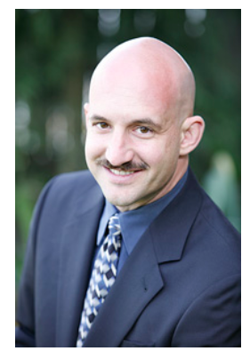
CAP Theorem
Conjectured by Prof. Eric Brewer at PODC (Principle of Distributed Computing) 2000 keynote talk
Described the trade-offs involved in distributed system
It is impossible for a web service to provide following three guarantees at the same time:
Consistency
Availability
Partition-tolerance

Slide 3
CAP Theorem
Consistency:
All nodes should see the same data at the same time
Availability:
Node failures do not prevent survivors from continuing to operate
Partition-tolerance:
The system continues to operate despite network partitions
A distributed system can satisfy any two of these guarantees at the same time but not all three

Slide 4
CAP Theorem
C
A
P

Slide 5

CAP Theorem
A simple example:
Hotel Booking: are we double-booking the same room?
Bob
Zheng

Slide 6

CAP Theorem
A simple example:
Hotel Booking: are we double-booking the same room?
Bob
Dong

Slide 7
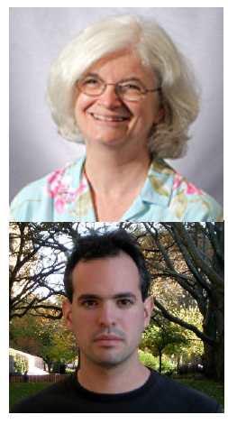
CAP Theorem: Proof
2002: Proven by research conducted by Nancy Lynch and Seth Gilbert at MIT
Gilbert, Seth, and Nancy Lynch. "Brewer's conjecture and the feasibility of consistent, available, partition-tolerant web services." ACM SIGACT News 33.2 (2002): 51-59.

Slide 8
CAP Theorem: Proof
A simple proof using two nodes:
A
B

Slide 9
CAP Theorem: Proof
A simple proof using two nodes:
Not Consistent!
A
B
Respond to client

Slide 10

CAP Theorem: Proof
A simple proof using two nodes:
Not Available!
A
B
Wait to be updated

Slide 11
CAP Theorem: Proof
A simple proof using two nodes:
Not Partition Tolerant!
A
B
A gets updated from B

Slide 12
Why this is important?
distributed (database) systems everywhere
CAP theorem describes the trade-offs involved in distributed systems, including edge systems
A proper understanding of CAP theorem is essential to making decisions about the future of distributed system design
Misunderstanding can lead to erroneous or inappropriate design choices

Slide 13
Revisit CAP Theorem
Of the following three guarantees potentially offered a by distributed systems:
Consistency
Availability
Partition tolerance
Pick two
This suggests there are three kinds of distributed systems:
CP
AP
CA
C
A
P
Any problems?

Slide 14
A popular misconception: 2 out 3
How about CA?
Can a distributed system (with unreliable network) really be not tolerant of partitions?
C
A
Notes:
What is replication and partitioning in distributed system?
Replication: Keep a copy of the same data on several different nodes. Partitioning: Split the database into smaller subsets and distributed the partitions to different nodes. Transactions: Mechanisms to ensure that data is kept consistent in the database.
What is data partitioning? Database partitioning is the backbone of modern distributed database management systems. It is a process of dividing a large dataset into several small partitions placed on different machines.
So, Partitioning is often a mandatory requirement for distributed systems because often databases are so large they need to be split among different devices (not merely that every device has a copy of the full database).

Slide 15

A few witnesses
Coda Hale, Yammer software engineer:
“Of the CAP theorem’s Consistency, Availability, and Partition Tolerance, Partition Tolerance is mandatory in distributed systems. You cannot not choose it.”
http://codahale.com/you-cant-sacrifice-partition-tolerance/

Slide 16

A few witnesses
Werner Vogels, Amazon CTO
“An important observation is that in larger distributed-scale systems, network partitions are a given; therefore, consistency and availability cannot be achieved at the same time.”
http://www.allthingsdistributed.com/2008/12/eventually_consistent.html

Slide 17
CAP Theorem 12 year later
Prof. Eric Brewer: father of CAP theorem
“The “2 of 3” formulation was always misleading because it tended to oversimplify the tensions among properties. ...
CAP prohibits only a tiny part of the design space: perfect availability and consistency in the presence of partitions, which are rare.”
http://www.infoq.com/articles/cap-twelve-years-later-how-the-rules-have-changed

Slide 18
Consistency or Availability
Consistency and Availability is not “binary” decision
AP systems relax consistency in favor of availability – but are not inconsistent
CP systems sacrifice availability for consistency- but are not unavailable
This suggests both AP and CP systems can offer a degree of consistency, and availability, as well as partition tolerance
C
A
P
Notes:
Typical example of AP system: DNS system (a distributed=partitioned database); also GIT hub.
Banking System is a typical example of CP.

Slide 19
AP: Best Effort Consistency
Example:
Web Caching
DNS
Trait:
Optimistic (locking)
Expiration/Time-to-live
Conflict resolution

Slide 20
CP: Best Effort Availability
Example:
Distributed Locking
Trait:
Pessimistic locking
Make minority partition unavailable

Slide 21
Types of Consistency
Strong Consistency
After the update completes, any subsequent access will return the same updated value.
Weak Consistency
It is not guaranteed that subsequent accesses will return the updated value.
Eventual Consistency
Specific form of weak consistency
It is guaranteed that if no new updates are made to object, eventually all accesses will return the last updated value (e.g., propagate updates to replicas in a lazy fashion)

Slide 22
Eventual Consistency Variations
Causal consistency
Processes that have causal relationship will see consistent data
Read-your-write consistency
A process always accesses the data item after it’s update operation and never sees an older value
Session consistency
As long as session exists, system guarantees read-your-write consistency
Guarantees do not overlap sessions

Slide 23
Eventual Consistency Variations
Monotonic read consistency
If a process has seen a particular value of data item, any subsequent processes will never return any previous values
Monotonic write consistency
The system guarantees to serialize the writes by the same process
In practice
A number of these properties can be combined
Monotonic reads and read-your-writes are most desirable

Slide 24



Eventual Consistency - A Facebook Example
Bob finds an interesting story and shares with Alice by posting on her Facebook wall
Bob asks Alice to check it out
Alice logs in her account, checks her Facebook wall but finds:
- Nothing is there!
?

Slide 25

Eventual Consistency - A Facebook Example
Bob tells Alice to wait a bit and check out later
Alice waits for a minute or so and checks back:
- She finds the story Bob shared with her!

Slide 26
Eventual Consistency - A Facebook Example
Reason: it is possible because Facebook uses an eventual consistent model
Why Facebook chooses eventual consistent model over the strong consistent one?
Facebook has more than 1 billion active users
It is non-trivial to efficiently and reliably store the huge amount of data generated at any given time
Eventual consistent model offers the option to reduce the load and improve availability

Slide 27

Causal Consistency - A Facebook Example
Bob posts: what a bad day.. My grandpa passed away in a car accident
Alice replies: is your grandma okay ?
Bob replies: yes, she is okay.
Alice replies: that’s great!
Cara only see the post and Alice’s final rely
?

Slide 28
Happen-before relationship (Casual Consistency)
An event is something happening at one node (sending or receiving a message, or a local execution step).
We say event a happens before event b (written a → b) iff:
a and b occurred at the same node, and a occurred before b in that node’s local execution order; or
event a is the sending of some message m, and event b is the receipt of that same message m (assuming sent messages are unique); or
there exists an event c such that a → c and c → b.
The happens-before relation is a partial order: it is possible that neither a → b nor b → a. In that case, a and b are concurrent (written a || b)

Slide 29
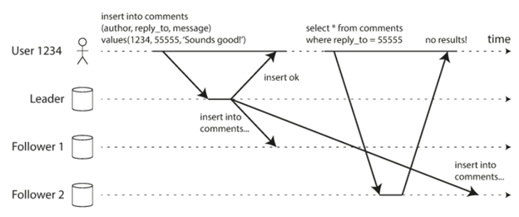
Read your own writes Consistency - A Facebook Example
Bob posts some thing
Bob refreshed his homepage
The post doesn’t show up!
Notes:
Solution: read your own write = when you make a post, you should also retrieve that post from the database to ensure you have written to the database and also so you give the network time to converge/synchronize.

Slide 30
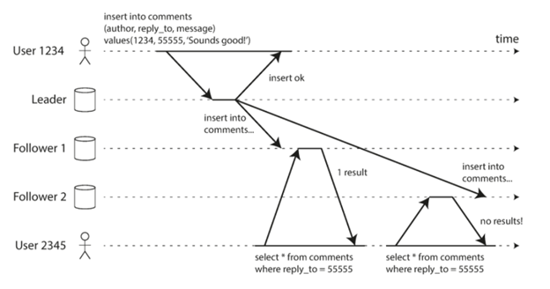
Monotonic reads Consistency - A Facebook Example
Bob posts some thing
Bob refreshed his homepage, and see the post
Bob refreshed his homepage again, and the post is gone!!
Notes:
Solution: use event ID!

Slide 31
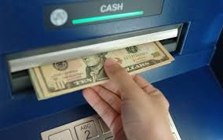
An ATM Example
In design of automated teller machine (ATM):
Strong consistency appear to be a nature choice
However, in practice, A beats C
Higher availability means higher revenue
ATM will allow you to withdraw money even if the machine is partitioned from the network
However, it puts a limit on the amount of withdraw (e.g., $200)
The bank might also charge you a fee when a overdraft happens
Notes:
So you could theoretically wait (or find out) the most busy time for the banking system and go to several ATMs and withdraw the limit even if your account does not actually have 200$...and you could do this several times (look up Australian man story who did this)
So you need to make sure you keep CAP theory in mind when programming a distributed system.

Slide 32
Dynamic Tradeoff between C and A
An airline reservation system:
When most of seats are available: it is ok to rely on somewhat out-of-date data, availability is more critical
When the plane is close to be filled: it needs more accurate data to ensure the plane is not overbooked, consistency is more critical
Neither strong consistency nor guaranteed availability, but it may significantly increase the tolerance of network disruption

Slide 33
Heterogeneity: Segmenting C and A
No single uniform requirement
Some aspects require strong consistency
Others require high availability
Segment the system into different components
Each provides different types of guarantees
Overall guarantees neither consistency nor availability
Each part of the service gets exactly what it needs
Can be partitioned along different dimensions

Slide 34
Discussion
In edge computing applications, what are the trade-offs between consistency and availability you can think of? What is your strategy?
For example,
Online video gaming
Distributed data storage
Does facial image recognition services require to consider consistency? – no
Notes:
One major design for edge computing: separate storage form computing → i.e. edge computing device focus on the computing.

